Slide 1
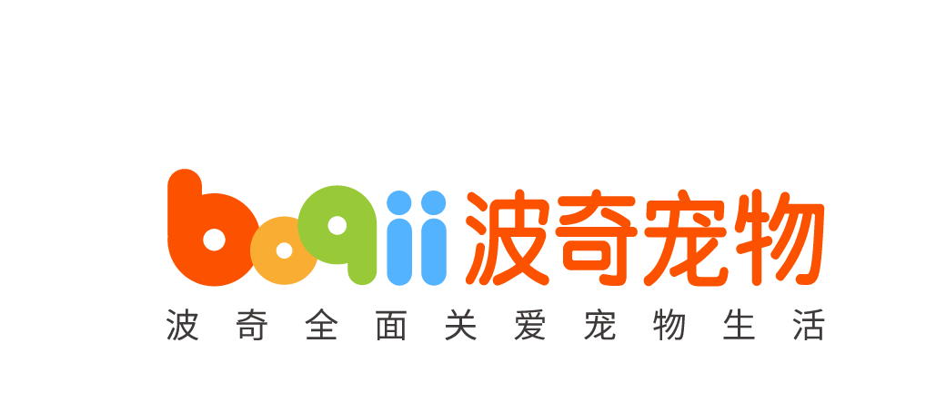




Slide 2

















INVESTOR FACTSHEET
Stock Information
ABOUT
Boqii Holding Limited (NYSE: BQ) is a leading pet-focused platform in China. We are the leading online destination for pet products and supplies in China with our broad selection of high-quality products including global leading brands, local emerging brands, and our own private label, Yoken and Mocare, offered at competitive prices. Our online sales platforms, including Boqii Mall and our flagship stores on third-party e-commerce platforms, provide customers with convenient access to a wide selection of high-quality pet products and an engaging and personalized shopping experience. Our Boqii Community provides an informative and interactive content platform for users to share their knowledge and love for pets.
(as of June 30, 2022)
Exchange: NYSE
Ticker Symbol:
BQ
Shares Outstanding:
15.28 million (ADS)
WHO WE ARE
We are the One-Stop Service Platform for Pets and Pet Parents
High Frequency
High Volume
Product Purchases
Low Frequency
High Value-Added Services
Trusted
Online
Community
Food and Treats
Shampoos, Cages, Toys…
Nutritional Supplements
OTC Pharmacy
Pet Adoption/Acquisition
Grooming
Pet Boarding/Training
Veterinary Services
Sharing
Educating
Social Networking
Promoting
BUSINESS MODEL
Omni-Channel Network
Supply Chain Capabilities
Contact Information
China
Boqii Holding Limited
+86 (21) 6882-6051
ir@boqii.com
UGC/PUGC Community
DLK Advisory Limited
+852-2857-7101
ir@dlkadvisory.com
Offline Touchpoints
BOQII HOLDING LIMITED FACTSHEET – 2022 http://ir.boqii.com/

Slide 3
INVESTOR FACTSHEET
INVESTMENT HIGHLIGHTS
Established industry leader covering full spectrum of the pet industry value chain
Strong e-commerce footprint and offline reach through 15,000+ physical pet stores and pet hospitals(1), covering 250+ cities in China(1)
Rich product assortments of 28,620 SKUs (2) from 745 brands(2)
Solid infrastructure to serve including nationwide supply chain and actionable database
Strong brand equity as customer acquisition cost hit a new low of RMB5.2 per user
FINANCIAL AND OPERATING HIGHLIGHTS
Total Revenues
QoQ: 26.1%
Revenue Mix by Channels
(RMB mn)
Boqii Mall
3rd Party E-commerce Platforms
Online marketing and information services and other revenue
Active Buyers
(mn)
Post-fulfillment Margin Trends
Note: (1) As of June 30, 2022 (2) As of June 30, 2022 (3) The Company defines post-fulfillment profit as gross profit excluding fulfillment expenses, and post-fulfillment margin as post-fulfillment profit as a percentage of total revenues
BOQII HOLDING LIMITED FACTSHEET – 2022 http://ir.boqii.com/

